Slide 1
Using Bodystorming to Help Convert Microphone Muting and Video Disabling Actions in a Video Calling Environment for Tobii Eye-Tracker Usage Robson Basha | 100750867 | February 26th, 2023

Slide 2
Outline
We used bodystorming to better understand how to implement microphone muting and video feed disabling in a one-on-one video call.
Two participants took turns assuming the role of a handicapped person trying to make a video call using the eye-tracking interactions.
Those who were not the actor took notes on the scene and what could be improved.
Changes to the interactions include more minimal UI design to not overstimulate the eyes, and staring at elements to confirm selection to reduce eye strain.

Slide 3
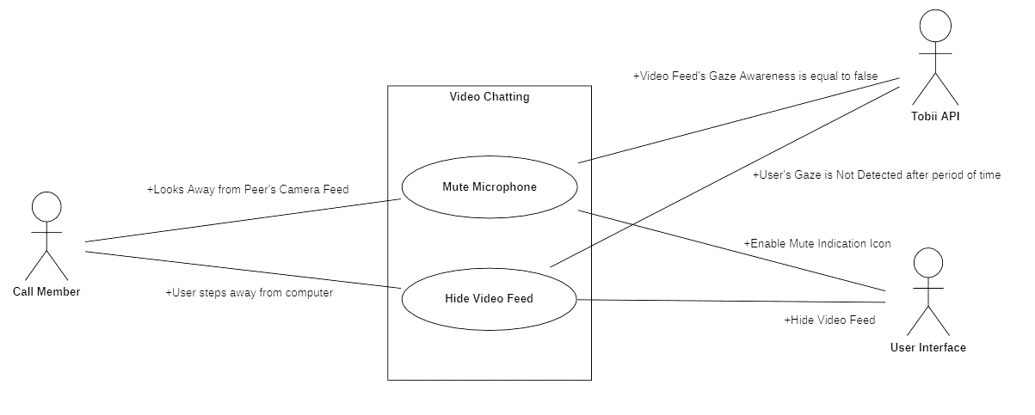
Introduction
We started by cutting down the scope of the interactions we want to map eye-tracking to.
This is so that we could focus on what was the most important aspects to convert and polish them to be as easy-to-use as possible.
We created a use case diagram for these two interactions, which were microphone muting and video hiding.
We thought that these two interactions made the most sense to convert to automated eye-tracking actions as they somewhat correlate with actions taken in the real world and are also used very frequently in one-on-one discussions.

Slide 4
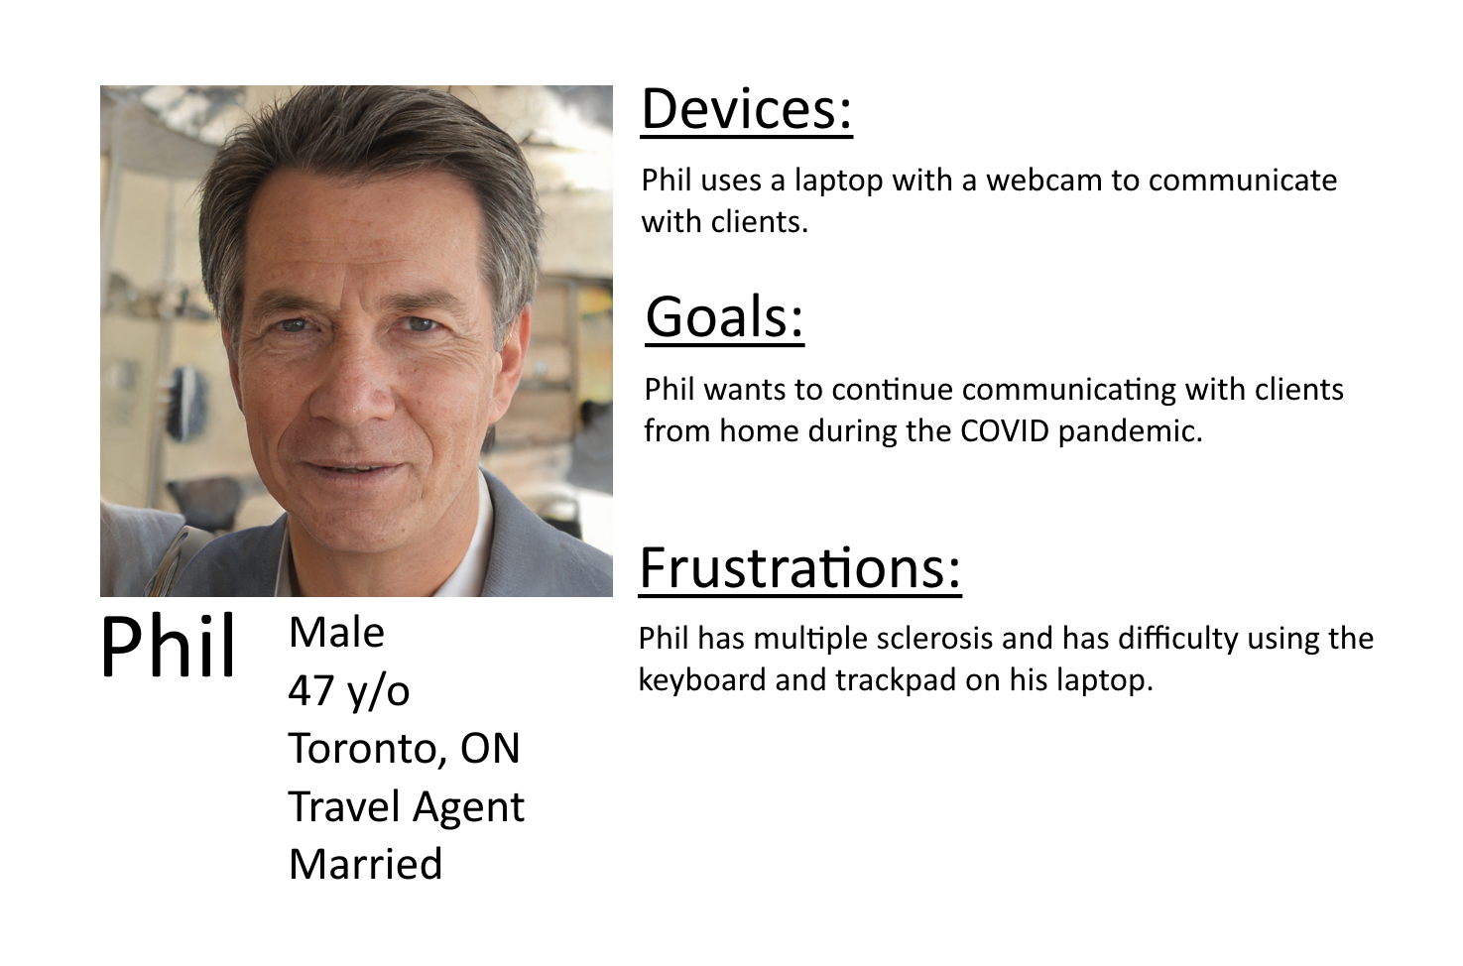
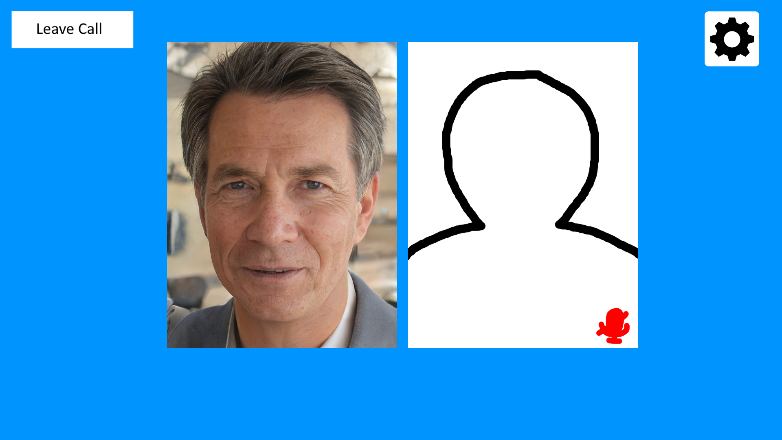
Methods
We created a persona that the actor would roleplay during the bodystorming session.
We then set up a laptop at a desk with a mock-up interface for the actor to use in conjunction with Tobii’s Gaze Trace to pretend we have a functioning prototype.
The actor would engage in the following:
Have a one minute back-and-forth discussion with a fake person to test the “Gaze to Speak”.
Walk away for a bit to test the automatic video disabling.
Return to laptop and click the “Leave Call” button with a blink.
The observer would take notes and pause the scene whenever they feel they have a what-if situation that could occur.

Slide 5
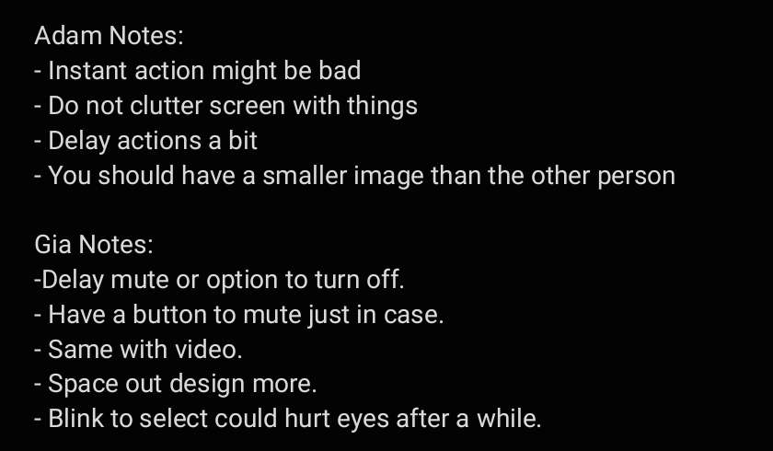

Results
We gathered the notes of both participants and read over them to get an understanding of where we went wrong in the design process.
We then made a rudimentary prototype in Unity using the layout in conjunction with the Tobii Integration SDK for Unity to test our use case again and see how we could improve it.

Slide 6
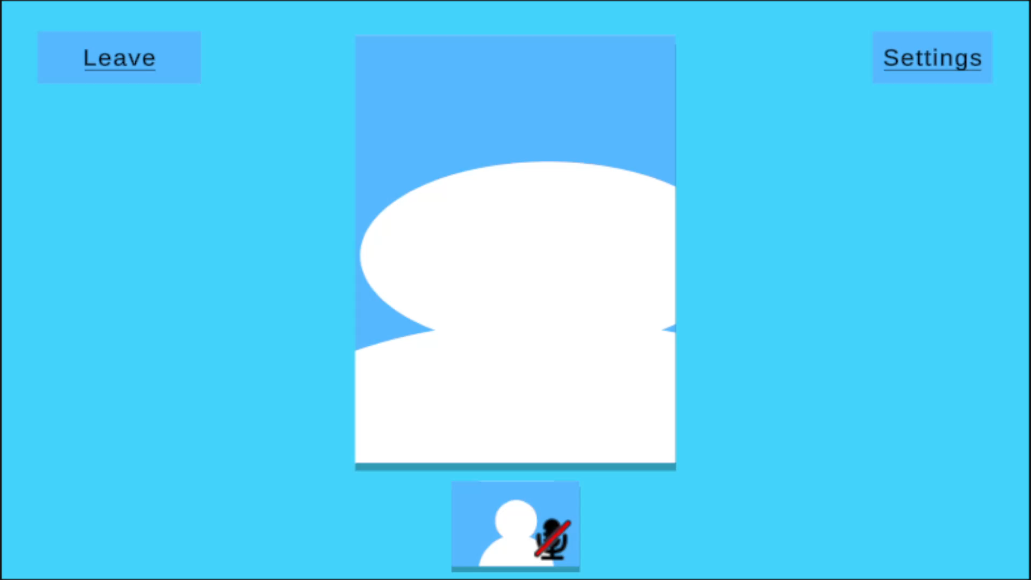
Demo

Slide 7
Discussion
Focusing on one-on-one calls was a good idea so that the eyes were not over-stimulated with multiple focus points.
This needs to translate to the rest of our UI design as well, if we put in manual disable buttons and other menu elements.
Having both video feeds next to each other can get confusing on where to look.
We want to focus on engaging with the other person.
Make your video feed a smaller square underneath theirs, with the potential option to swap placements in a menu.
Blinking for a long period of time can cause fatigue and would render the user unable to use the interface.
Stare for a period of time with visual feedback on selection completion.

Slide 8
Acknowledgments:
Persona face created using ThisPersonDoesNotExist. (https://this-person-does-not-exist.com/)
Tobii Integration SDK for Unity provided by Tobii AB.

Slide 9
End of Presentation

